Slide 1
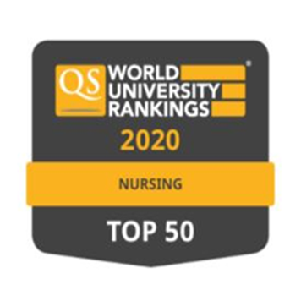
Finland
FINE Symposium 11.12.2020
Impact of covid19 on nursing education in Europe
Helena Leino-Kilpi, RN, PhD, FAAN, FEANS, MAE
Professor and Chair, University of Turku, Dpt of Nursing Science
Nurse Director (part-time), Turku University Hospital
Visiting professor, Trinity College Dublin, School of Nursing and Midwifery
Acknowledgements: PhD, NT Riitta-Liisa Lakanmaa and PhD, NT Satu Kajander-Unkuri

Slide 2
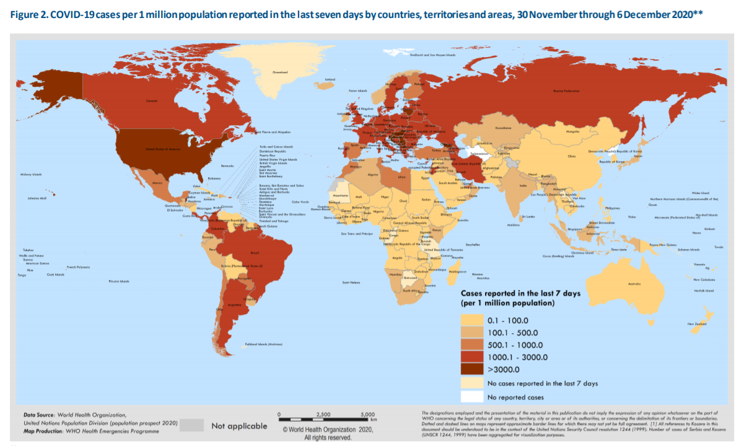
Nursing education
Universities of Appleid Sciences
UAS 22
Bachelor (RN), 10000-11000/yr
Master (shorter), 2000/yr
Universities 5
University master, 250/yr
PhD, 25-30/yr (nursing)
Finnish population 5.5 milj.
28 732 infected
433 died
233 in hospital (9.12.2020)
27 in intensive care (9.12.2020)
WHO, 6.12.2020

Slide 3
Changes
Spring 2020: 03-05/2020 total lock-down (in school and practice)
Fall 2020: hybrid model (theoretical teaching on-line, seminar/groupwork at school, in practice different arrangements)
⬇
*digitalisation ⬆
*difficulties with assessments/evaluations (test labs closed)
*group-arrangements
*specified contracts for practicum – increased responsibility for students
*delayed graduation (18%, 37% unsure)
*students’ satisfaction 3.1 (1-5 scale)
*teachers – heavy workload
*research progressed in time (some delays due data collection)

Slide 4
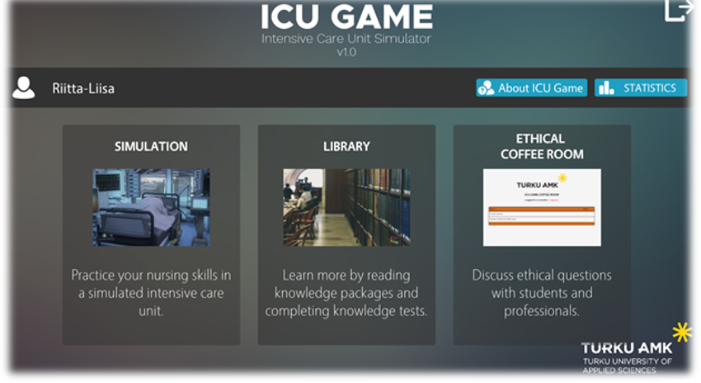
Digitalisation + creative teachers + responsible students
Applications/games for several purposes (intensive care ICU game, for ethics, for several clinical fields
Simulation labs – new developments
controlled tests (medication,
diagnostics (e.g.Covd19), hygienic
procedures (e.g. hand washing),
intensive care (e.g. ventilations)
New national final tests/evaluations at
the end of education
☺ Students responsibility of behaviour
☺ Learning outcomes- no systematic knowledge
Lakanmaa RL 2019

Slide 5
Nurses and Covid19 in Finland
Surveys among nurses (n=2344), Finnish Nurses Association
Leave the profession (more than 50%)
Worries about work health safetyness (51%)
Burnout (40%)
Worries about changing work/ward/unit (about 30% not satisfied)
Image of profession, proud (more than 70%)
⬇
leadership better
clear instructions for work
more staff/payments

Slide 6
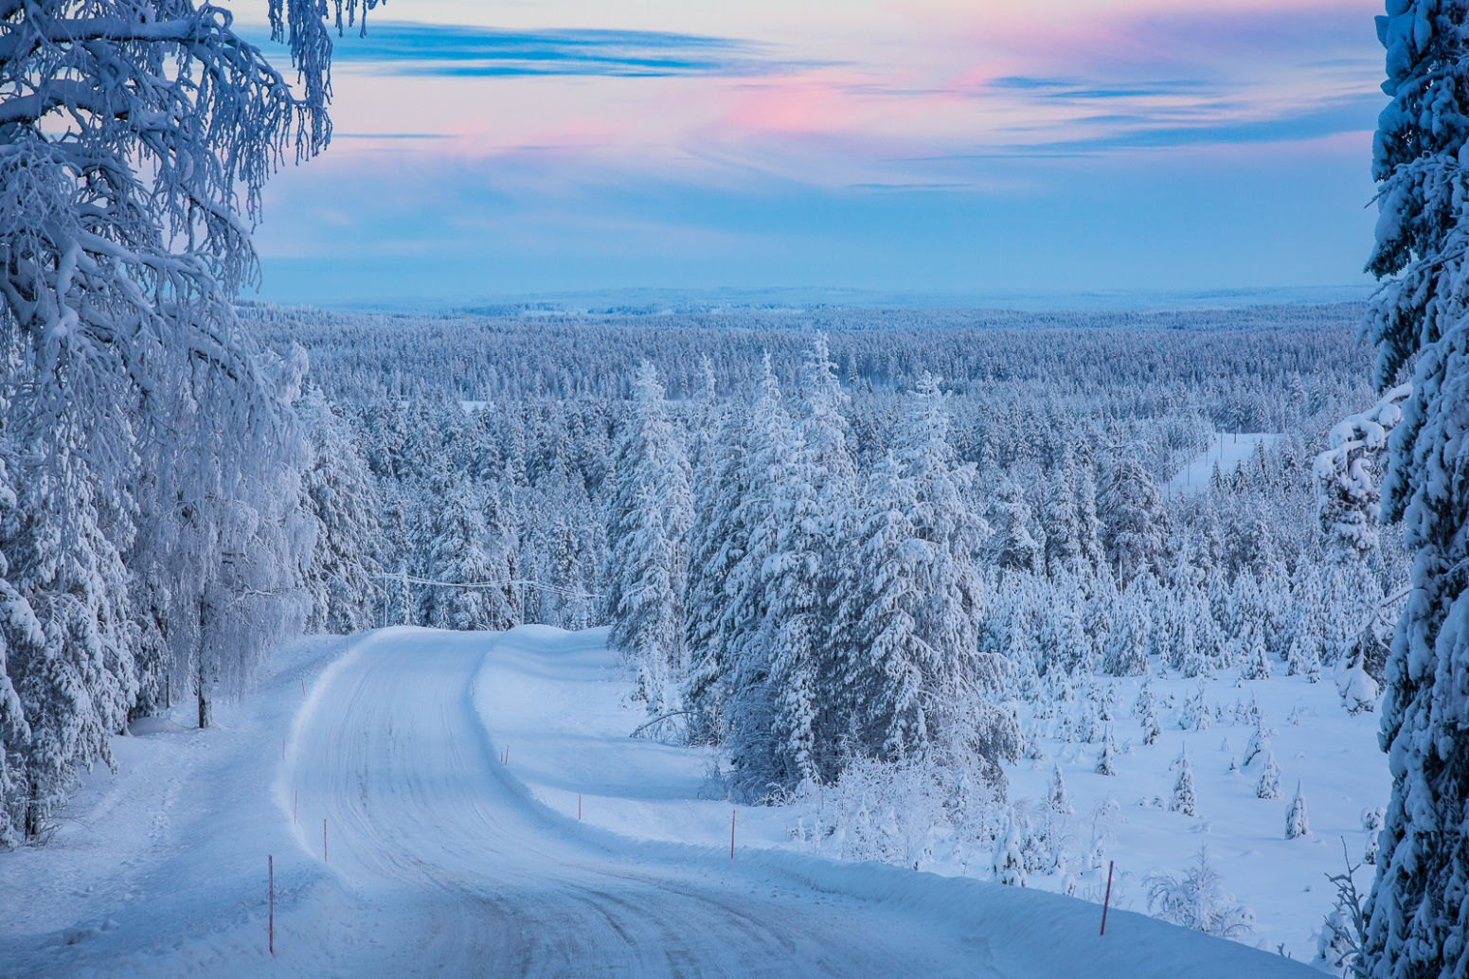
Thank you for your interest!

