Slide 1
Impact of Covid19 crisis on nursing education in Europe
THE SPANISH SCENARIO
Azucena Pedraz Marcos
Notes:
Good morning, first of all I want to thank the European Federation of Educators in Nursing Science for allowing me to tell about the experience of our University in handling the crisis generated by Covid19 in the training of Nursing students. I want to point out that, although many of the situations that will be presented have been similar in other universities, it may be too pretentious to talk about the Spanish scenario in the title, because there have been numerous peculiarities within the country.

Slide 2
SUMARY
Identify innovations introduced in both the educational and technological fields.
Identify the difficulties encountered.
Compile the lessons learned in a crisis situation as well as in a normal operating mode.
Measuring the first impacts of the crisis and the changes made to the system.
Formulate recommendations in this area.
Notes:
I will follow the scheme proposed by FINE for the presentation, but first of all I would like to present the initial chronology of the crisis generated by Covid 19 in our country, and how this affected the training of our students.

Slide 3
Introduction
6 Mar.
By mutual agreement with the Directions of Nursing in the hospitals and primary health centres we sent our students out of the clinical training.
10 Mar.
The University sent all the students home.
14 Mar.
The Spanish Government confined the whole population at home for 7 weeks.
20 Jun.
The Rector of the Autonomous University of Madrid signed a resolution to return attendance at the university.
Notes:
On Friday March 6, in view of the progress of the infection in the university hospitals, it was decided to suspend the clinical practices of the Nursing students. At that time, the suspension affected the final year students, who had 1 month left to finish the last internships of their career, and the 2nd year students, who were pending to carry out a 5-week rotation, after Easter week.
On March 10, the Rector of the Autonomous University of Madrid decided to suspend all face-to-face teaching activities and on March 14, the Government of Spain announced a confinement of the entire population that lasted for 7 weeks.
Until June 20, the face-to-face activity was not resumed at the Autonomous University of Madrid.

Slide 4
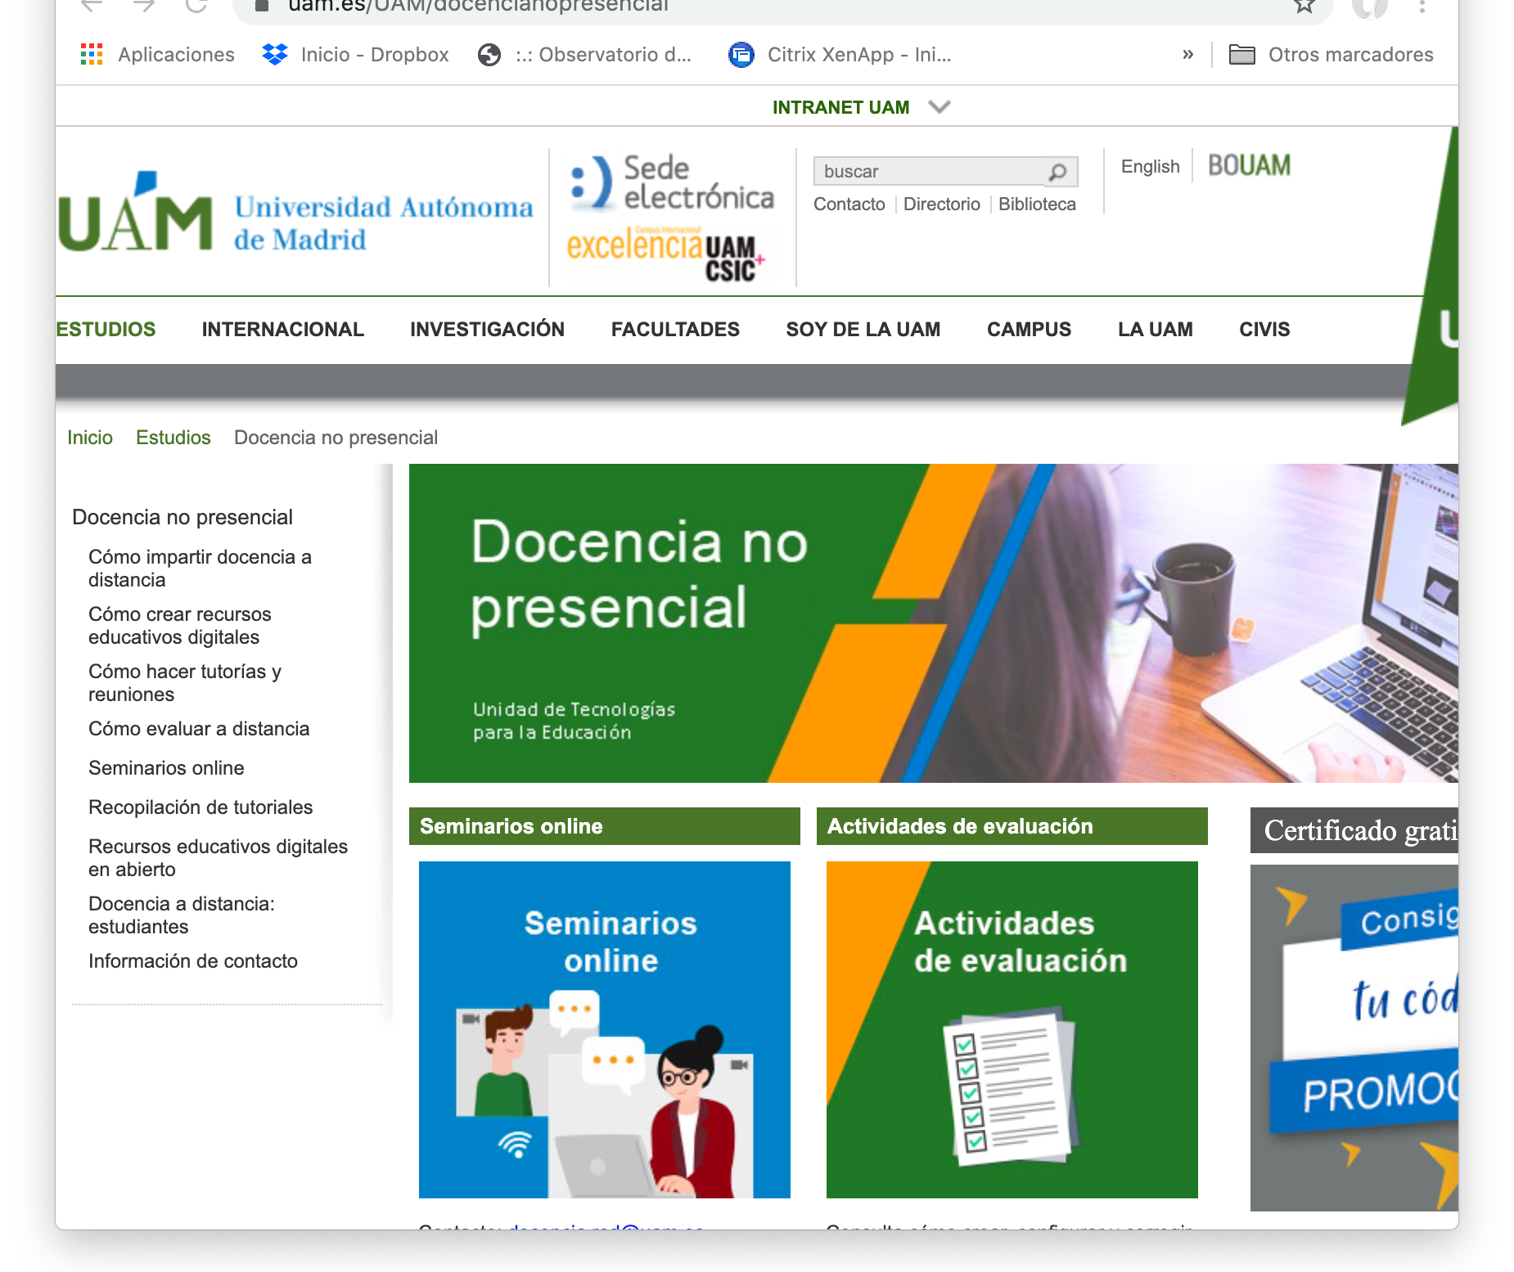
Innovations in education and technology
The number of possibilities offered by new technological tools is infinite, but the ability to implement them by teachers was shown to be a challenge in times of crisis.
Notes:
Since the suspension of face-to-face training activities was decreed, the University made a great effort to promote the use of tools for non-face-to-face teaching. A specific web page was created, with resources for teaching and evaluation. The Moodle platform, which had already been used for years, was maintained as the usual repository for teaching materials for each course, and the Teams platform for virtual teaching was promoted. The customer service for new technologies was reinforced and the number of courses available to teachers for the use of learning tools was increased: Kahoot, Mentimeter, Genially, Miro.

Slide 5

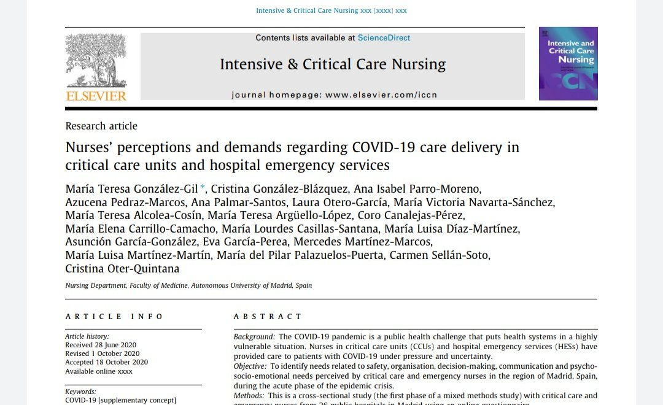
Difficulties encountered
Difficulties with the clinical training.
Difficulties with the non face-to-face teaching
Difficulties with assessment of the courses
Notes:
The difficulties encountered in the process have been fundamentally of three types:
- Difficulties around clinical practices: Students were unable to return to hospitals and health centers for the remainder of the course. The 2nd year students lost the opportunity to take the intership they were missing, because the regional Ministry of Health did not allow them to return to the health centers for training until well into July.
On the other hand, the Ministry of Universities authorized the curricular compensation of the final year students who had carried out more than 80% of the internships of the degree. Some of them, like some of the teachers, were recruited as volunteers in the toughest weeks of March and April, as reinforcement in the units where they had done their internships. It was a hard time, especially in the Emergency services and in the Critical Care Units and on this, several professors from the Nursing Department have published a work in Intensive and Critical Care Nursing on the impact of Covid-19 on these professionals. Another study, recently presented at the 24th International Nursing Research Conference, held in Pamplona, ​​described the effects of the premature incorporation of nursing students to the healthcare setting.
Difficulties were also encountered in non-face-to-face training, by students and teachers. The former, because in some cases of social vulnerability, they did not have a computer and / or internet connection in their homes to be able to follow the online learning. The University loaned tablets for these students for this purpose. In the case of teachers, the greatest difficulty, as noted in the previous slide, was the lack of competence in the use of new educational technologies.
In relation to the coruses´ assessment, the greatest difficulties encountered were again the use of technology. Fortunately, the ordinary examination call did not begin until the second week of May and, by then, the University had already agreed on formulas to carry out the evaluations in a synchronous or asynchronous way, through the Moodle Platform.

Slide 6
Lessons learned in a crisis situation as well as in a normal operating mode
Collaboration networks
Importance of the clinical training
New technologies have come to stay
Notes:
Among the lessons learned in this pandemic situation, I believe that the most important has been the need for interconnection and collaboration of all the actors: University, Ministry of Health, Ministry of Education, at the macro level; but also, chief nurses of the health centers, director of the Nursing Department, conference of deans of nursing, at the meso level; and at the micro level, permanent communication with representatives of students and teachers, for the "normal" development of learning in times of pandemic.
On the other hand, the European Directive of 2005 on the recognition of professional qualifications clearly states that the duration of the clinical training is at least one half of the minimum duration of the training, and that the clinical training “shall take place in hospitals and other health institutions and in the community, under the responsibility of nursing teachers, in cooperation with and assisted by other qualified nurses”. No way for non face-to-face solutions or simulations or virtual learning, so far.
But, new technologies have come to stay. So we have to encourage the university community to incorporate them in our teaching and learning. Sure, we will need a lot of help to go From Novice to Expert, following the Patricia Benner five step model. And this means a greater investment of our universities in technological infrastructures, which support the regular activity of these educational technologies; in aid for the transformation of face-to-face teaching into online teaching, and in training for the mastery of new technologies by teachers.

Slide 7
Measuring the first impacts of the crisis and the changes made to the system.
Impact on the clinical training: Need to ensure clinical practices, to ensure future generations of nurses
Impact on the theoretical education: Adaptation to the use of new technologies in the teaching environment.
Impact on the evaluation process: Search for better formats for evaluating competencies in all settings.

Slide 8
Formulate recommendations in this area
Work
Work hard so as not to leave anyone out of the system. Neither teachers nor students.
Think about
Think about whether it is necessary to modify European legislation to incorporate learning in virtual or simulation environments into clinical training.
Establish
Establish permanent work groups, as a think tank, for better and faster adaptation to crisis situations.

Slide 9
Thank you, very much!

