Slide 1

FINE WEBINAIRE
2020

Slide 2






Who we are/ qui sommes nous ?
Dr Isabelle Bayle
Dr Jane-Laure Danan

Slide 3
SOMMAIRE
Des besoins du terrain vers l’appareil de formation le dispositif PCC
De l’appareil de formation vers le déploiement des apprenants sur les terrains professionnels
From the needs of the field to the training device “preventing the consequences of confinement” PCC
From the training system to the deployment of learners in the professional field

Slide 4
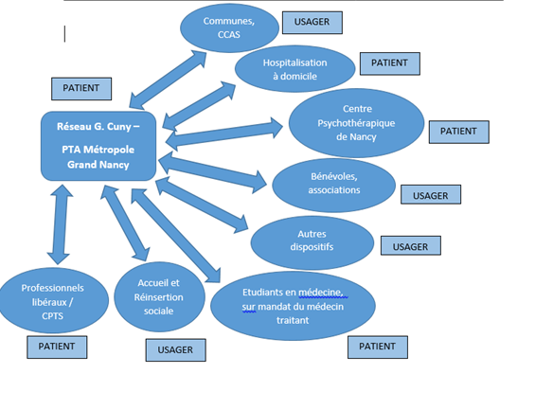




LE CONTRAT LOCAL DE SANTE
Circuit coordonné d’alerte et de partage d’informations utiles en fonction des missions et compétences de chacun
Coordinated alert and information sharing circuit based on each individual's missions and skills
Centré sur la personne et son entourage
Focused on the person and his or her relatives family or caregivers
Formation de 200 étudiants (150 dans le dispositif et 50 en stage ) par le DR Eliane Abraham directeur de la PTA réseau Cuny .
4 sessions de 1h30 en Visio
secret professionnel /relation de soins / brief sur le questionnaire
750 patients suivi de pendant 3 mois puis relais pris par les bénévoles de la croix rouge et opa
des septembre le doyen de la faculté intègre cet enseignement dans le cursus des 2 ème année , 10 heures de théorie et 20 de heures de stage
Training of 200 students (150 in the system and 50 in internship) by DR Eliane Abraham, director of the PTA Cuny network.
4 sessions of 1h30 in Visio
professional secrecy / care relationship / brief on the questionnaire
750 patients followed for 3 months and then relayed by Red Cross volunteers and opa
From September the Dean of the Faculty integrates this teaching into the curriculum of the second year, 10 hours of theory and 20 hours of internship
Le must ! création d’un dispositif d’auto apprentissage et d’entre -aide
1oo euros chèque vacances et un coup de pouce rentrée de 100 euros ,

Slide 5
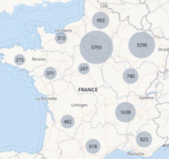
Des besoins du terrain vers l’appareil de formation le dispositif PCC
Depuis le début de la crise du coronavirus Covid-19, les pouvoirs publics, dans leur ensemble, courent après les événements, faute d’avoir la capacité de suffisamment les anticiper.
Le concours des collectivités territoriales semble indispensable, ne serait-ce que dans un rôle de médiation et d’explication à l’égard des populations, en particulier les personnes qui ont le plus besoin d’une approche humaine et personnalisée de la gestion de la crise
C’est dans ce contexte et en plein confinement qu’a été conçue l’expérience « Prévention conséquences confinement »
L’idée était de ne pas prendre de retard en cas de nécessité d’intervention, et de se compléter pour pouvoir être disponible pour le plus grand nombre et qu’il n’y ait pas d’oubliés sur notre territoire métropolitain
Ce projet a eu un double impact. Tout d’abord, il a été en mesure de prévenir de nombreux problèmes de santé dans cette population fragile avec une utilisation optimale du système de soins de santé médicale.
Deuxièmement, il a permis aux étudiants en médecine de premier cycle d’effectuer leur première expérience en tant que membre responsable du système de soins de santé.
En plus de fournir un service précieux, crucial en cette période COVID, ils ont montré leur esprit de collaboration et amélioré leurs compétences médicales d’une manière complètement nouvelle et innovante
Since the start of the Covid-19 coronavirus crisis, it has been clear that the public authorities, as a whole, have been chasing after events because they have not been able to anticipate them sufficiently.
The assistance of local and regional authorities seems indispensable, only in a role of mediation and explanation towards the population, especially those who are most in need of a human and personalised approach to crisis management.
It is in its context and in full confinement that the "Prevention consequences confinement" experiment was designed.
The idea was not to fall behind when intervention was needed, and to complement each other so that we could be available to as many people as possible and so that no one would be forgotten in our metropolitan area
This project had a double impact. First, it was able to prevent many health issues in this fragile population with an optimal use of the medical health care system. Second, it enabled the undergraduate medical students to perform their first experience as a responsible member of the healthcare system. In addition to provide a valuable service, crucial in this COVID period, they showed their collaborative spirit and enhanced their medical skills in a completely new and innovative manner
Covid-19
Point de situation
LE VIRUS TOUCHE PARTICULIÈREMENT
LES PLUS FRAGILES
+ 60 ans
représentent 96% des décès
+ 70 ans
représentent 86% des décès
+ 80 ans
représentent 62% des décès

Slide 6




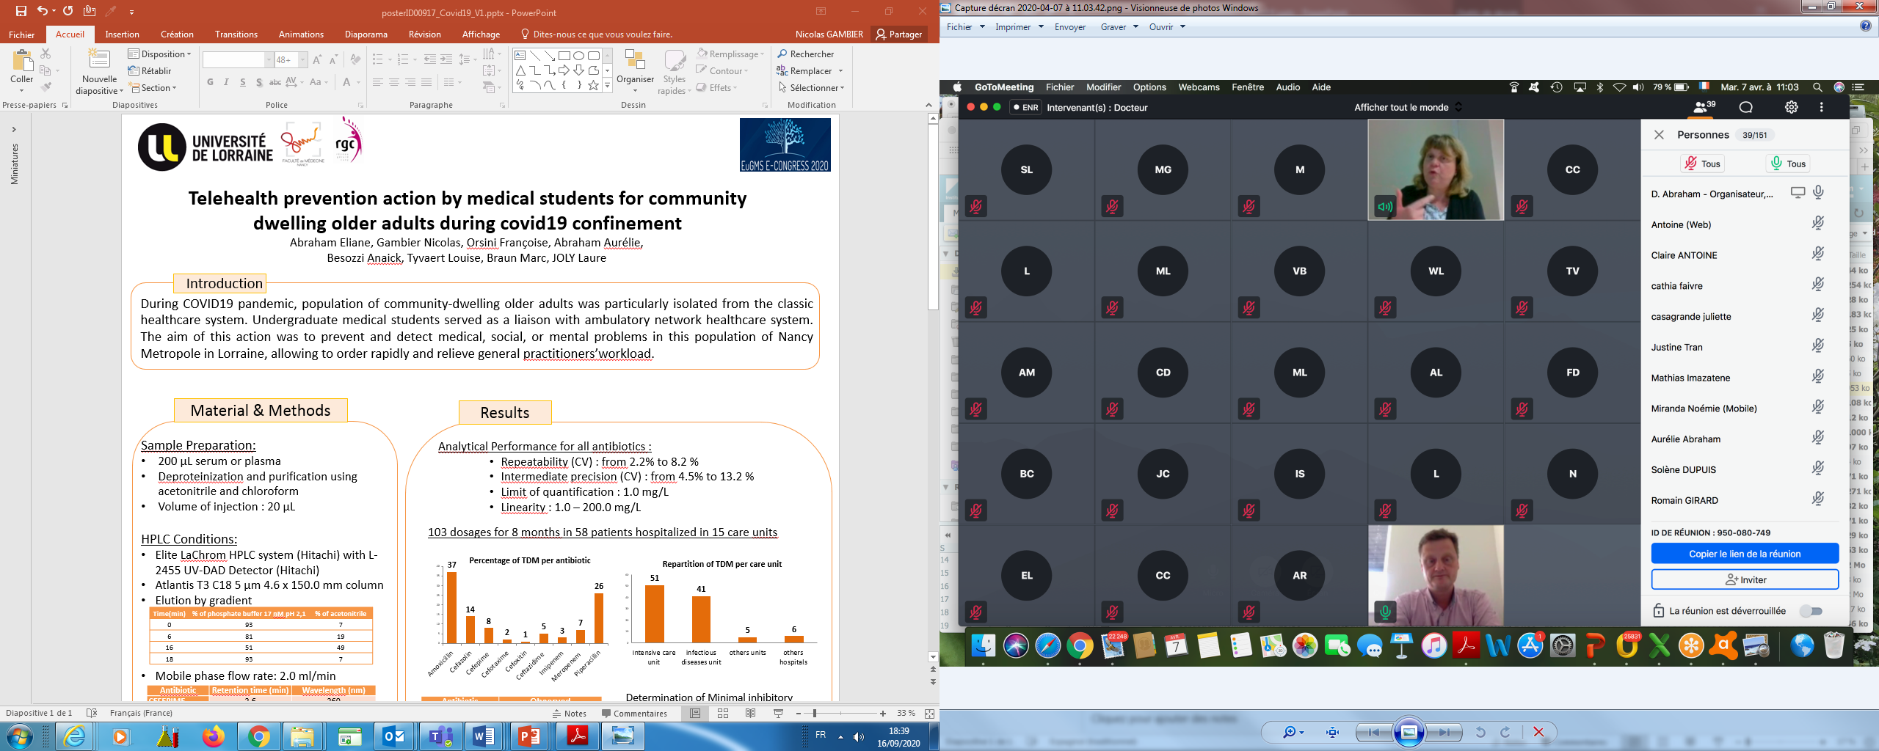
Telehealth prevention action by medical students for community dwelling older adults during covid19 confinement
Abraham Eliane, Gambier Nicolas, Orsini Françoise, Abraham Aurélie, Besozzi Anaïck, Tyvaert Louise, Braun Marc, Joly Laure
Introduction
During COVID19 pandemic, population of community-dwelling older adults was particularly isolated from the classic healthcare system. Undergraduate medical students were requested to serve as a link between this population and the ambulatory network healthcare system. The aim of this action was to prevent and detect medical, social, or mental problems in this population of Nancy Metropole in Lorraine, allowing a fast and adequate reaction while relieving general practitioners’workload.
Methods
Population
Targeted subjects
People of any age and any pathology, finding themselves at home without the ability to adapt in the medium or even long term in a suddenly disturbed daily life because of the Covid19 confinement. Subjects living in Nancy Metropole, Lorraine, France were included by their general practitioner in a survey network system named “Reseau Gerard Cuny – Plateforme Territoriale d’appui de la metropole du Grand Nancy” (PTA). This organization was created in 2005 : a mobile team of nurses and geriatricians are at the disposal of carers, patients and their helpers. It aims, on the one hand at evaluating the medico-psycho-social status of the patient in his home and on the other hand, at providing the patient to the convenient health services. The GP and his patient are deeply involved in each step of the process.
Students
Undergraduate Medical students (2nd and 3rd years) were asked to participate in this program. They were free to participate. No financial compensation was provided.
Students training
All medical students involved in this program followed a dedicated training by videoconference to strategic, safe, smart, and resource-conscious way.
General Practitioner
PTA’s doctors, also teachers
Medical Students
Medical
PTA’s DoStudentsctors
Health professionals
Volunteers (red cross, ...)
Figure1.
Virtual plateform used for medical students training
General Practitioner
Protocol
Each student was in charge of 3 to 5 subjects. For each subject, they had specific medical information given by the PTA, connected with each general practitioner. The students had to contact by phone their subject several times per week during the confinement period (from March, 17th to May, 11^{th)} They had to provide them social contact according to a well-defined protocol written by the Territorial Platform of Support (PTA) of Grand Nancy. Several objectives were defined (see on the dedicated paragraph)
At the end of the experience an evaluation form was sent to the general practitioners, students and patients in order to collect qualitative and quantitative feedback.
Figure2. Health network from GP to GP, patients centric
Objectives
Maintain a social link, a space for exchange and dialogue: listen, explain, reassure...
Enable an early tracking of needs to be covered, in the context of daily life
Early detection of signs of decompensation, loss of quality of life, ...
Be able to alert the geriatrician of the PTA as often as necessary
Allowing General Practitioner to mainly devote their activity to acute situations
Results
Student Volunteered | 145
Mission duration | 10 weeks
Patients
Beginning of the mission | 782
Inclusion during mission | 80
End of the mission | 608
Number of patients per student | 3 - 5
Call duration | About 6 hours/week per student
General Practioner | 180
General Practioners’ opinion?
Nothing to say, a very good initiative!
A patient's daughter told that her mother felt that the student listened to her while her children no longer listened to her.
Many compliments, very touched that their patients are called even on national holidays!
Patients very happy with calls
Congratulations!!!
Keep going, don't give up and good luck!
Positive feedback from its patients
Thanks to this action, I’ve been warned about two persons who really needed quick medical assistance although they didn’t call for help !
Conclusion
This project had a double impact. First, it was able to prevent many health issues in this fragile population with an optimal use of the medical health care system. Second, it enabled the undergraduate medical students to perform their first experience as a responsible member of the healthcare system. In addition to provide a valuable service, crucial in this COVID period, they showed their collaborative spirit and enhanced their medical skills in a completely new and innovative manner.

Slide 7
ENSURING QUALITY TRAINING IN THE CONTEXT OF A HEALTH CRISIS: AN ISSUE IN THE DAILY ACTIVITY OF HEALTH TRAINING INSTITUT
NURSES SCHOOLS
Training management
Ensure quality training
Building the professionalization of learners
Preserving well-being in traininng health care activities in the context of a health crisis
Health crisis COVID 19
Adapt the training device
Accompanying learners
Year of training/number of months of training
New construction of the alternation of training
Training course
Skills developed
Innovative teaching methods
Hybridization
Simulation
ENSURE VALIDATION OF TRAINING AND GRADUATION
Assignment of the professional placement

Slide 8
PREMIER CONSTAT
Réponse territoriale
Partenariat coordonné avec les directions, les directions des soins, les cellules de crise
Déploiement inscrit dans la durée
Dispositif de formation
Restructuration de la maquette pédagogique
Communication importante par rapport aux intervenants, aux apprenants
Apprenants
En fonction de l’équipe d’affectation :
Toutes les structures demandeuses ont eu des ressources
Construction d’une nouvelle offre de formation (outils numériques/plateforme)
Mobilisation des cadres de santé formateurs sur le terrain affaiblissement des équipes
Développement des compétences/reconnaissance du travail/ valorisation des actions entreprises apprenants satisfaits
Remplacement de personnel/pas d’encadrement/ pas de reconnaissance apprenants insatisfaits
Suivi individualisé / soutien de la part des équipes pédagogiques voir un suivi avec un psychologue
Reconnaissance financière par l’état et des actions locales
Déploiement adapté et ciblé aux besoins exprimés

Slide 9
FIRST OBSERVATION
Territorial answer
Long terme deployment
Training device
Restructuring of the pedagogical model
Important communication in relation to intervenants, learners.
Learners
Depending to assignment team:
All the requesting structures had resources
Mobilisation of health executives as trainers in the field Weakening of teams
Skills development/work recognition/ valuation of the actions undertaken satisfied learners
Staff replacements/no framing/ no recognition unsatisfied learners
Individualized follow-up / support from the pedagogical teams see a follow-up with a psychologist
Coordinated partnership with directions, care directions, crisis units
Deployment adapted and targeted to the needs expressed.
Construction of a new training (digital tools/platform)
Financial recognition by the State and local actions

Slide 10
Merci

