Slide 1
Impact of Covid-19 on nursing education in Europe – an example from Germany Institute for Health and Nursing Sciences Medical Faculty Martin Luther University Halle-Wittenberg Halle (Saale), Germany

Slide 2
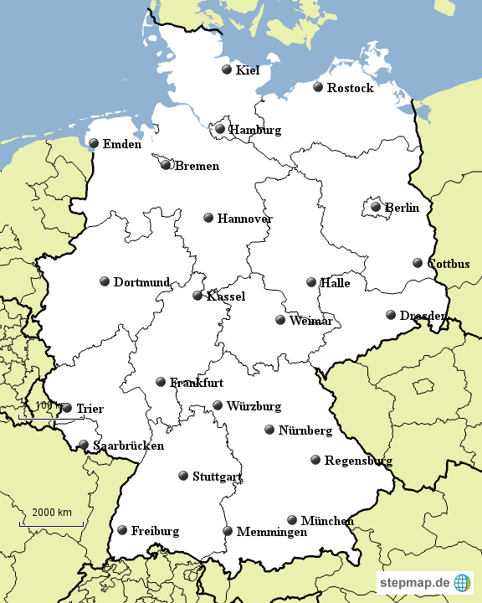
Saxony Anhalt
https://www.stepmap.de/karte/deutschlandkarte-1-Dg5y8Yk2Mx

Slide 3
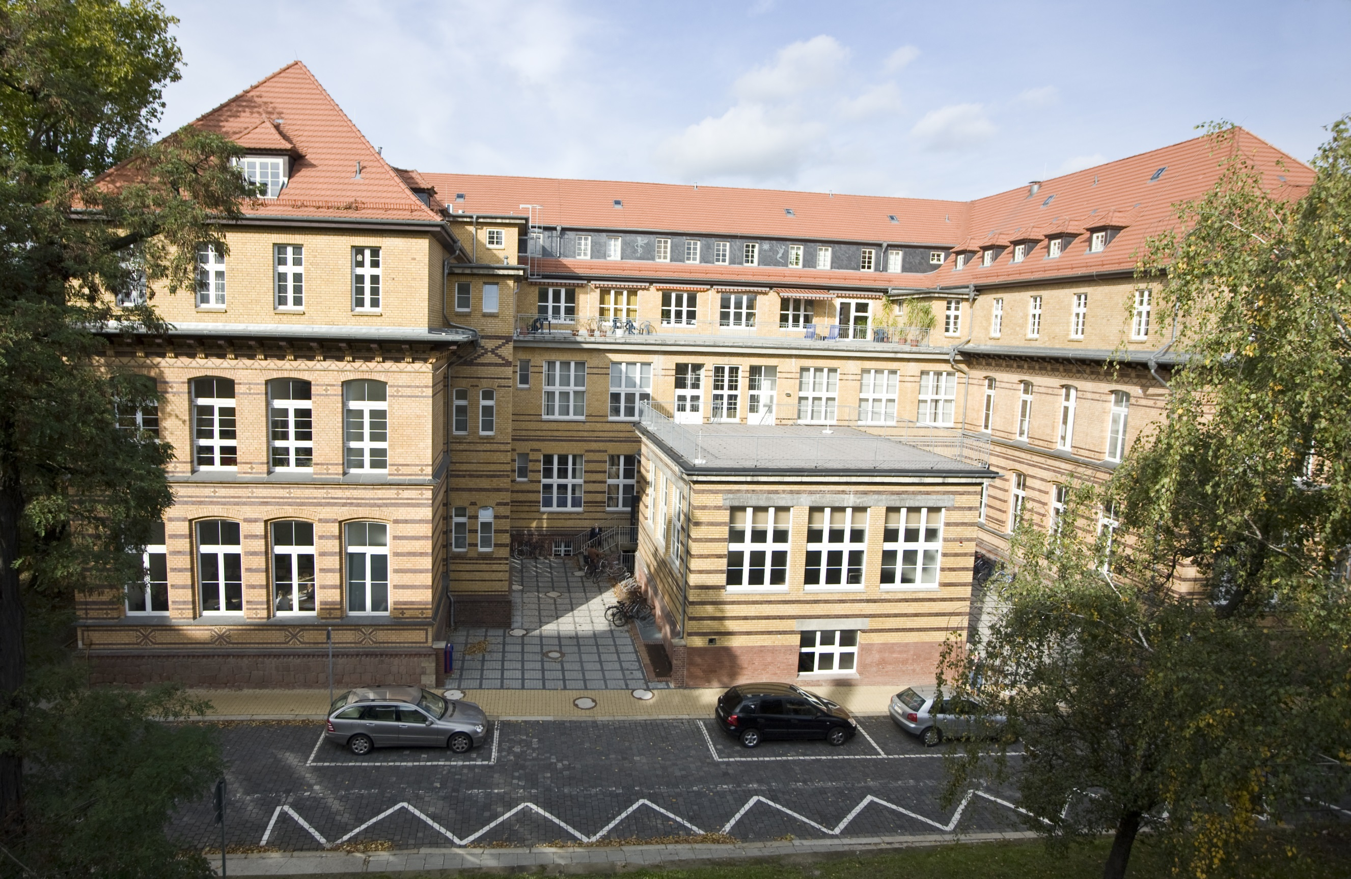

Slide 4
Bachelor Nursing Science
Doctoral Programme Health and Nursing Science
Master Health and Nursing Science

Slide 5

March/April 2020
Paralysis
https://blog.bodoschaefer.de/angst-ueberwinden

Slide 6
Learning curve
Era of digital competences
Iron age
Bronze age
Stone age
Level 2 – online lectures, real time, interactive, breakout rooms, online tools, hybrid formats, regular students‘ surveys
Level 1 – power point presentations and recorded speech, requests via email
Level 0 – power point presentation, not recorded and working sheets
Still space for further development, e.g. exams
Body in charge for examinations frozen
Some colleagues are denier

Slide 7
Fast track self-organised advanced training
Online meetings for teaching staff (bi-weekly), exchange of experiences (video conference systems, what works, students‘ response etc.), exercises to improve interactive formats
Peer teaching
Counselling offed by one skilled colleague
Support at the University level

Slide 8
Nursing practice and skills‘ training
Clinical nursing practice: no changes in terms of education, instruction, examination; hygiene protocol
Clinical simulation: small group teaching, hygiene protocol, FFP2 masks, some learning scenarios are modified or not available, simulated patients

Slide 9
Currently – rising numbers of positive test results among students
Online education only in January
No clinical simulation small groups
Clinical nursing education not affected

