Slide 1


Welcome to Turku,
Department of Nursing Science,
University of Turku
FINE workshop 2015

Slide 2
GROUP 3
RESULTS OF DISCUSSIONS

Slide 3
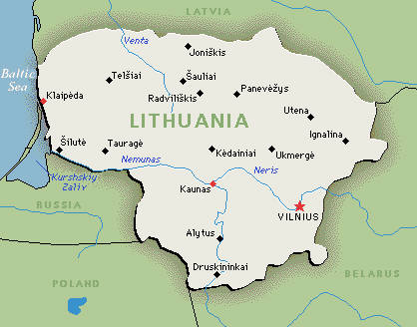
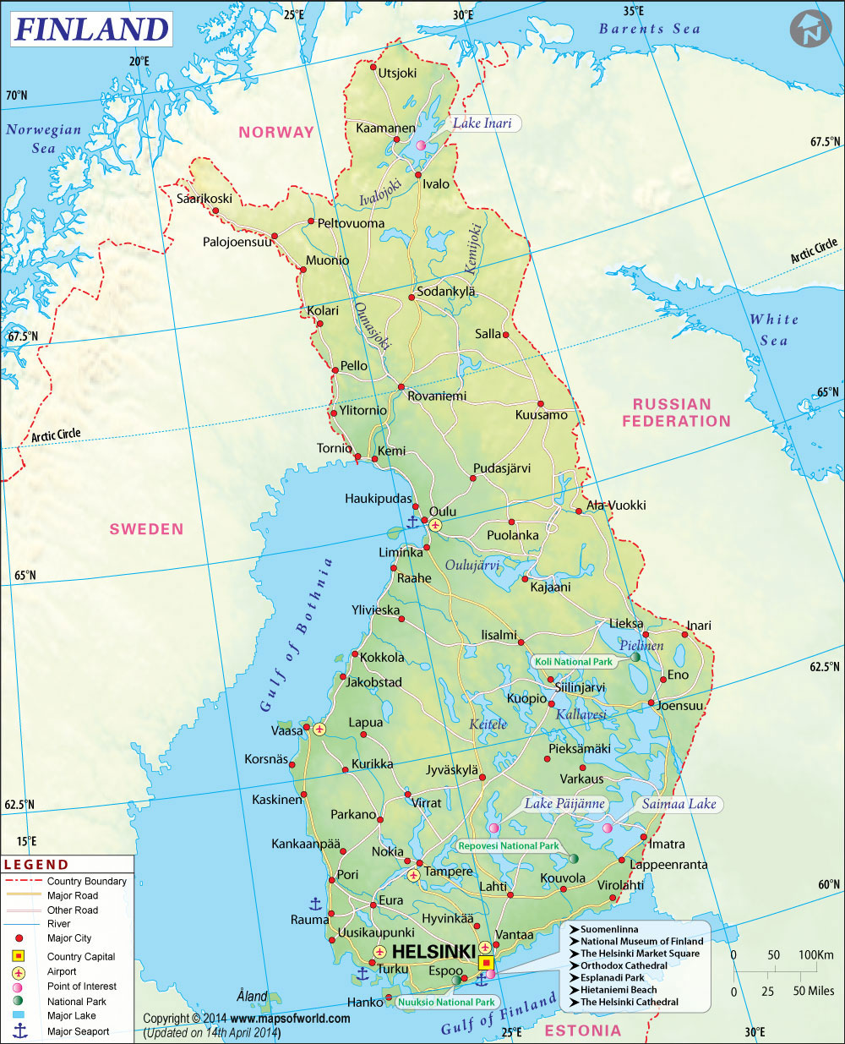
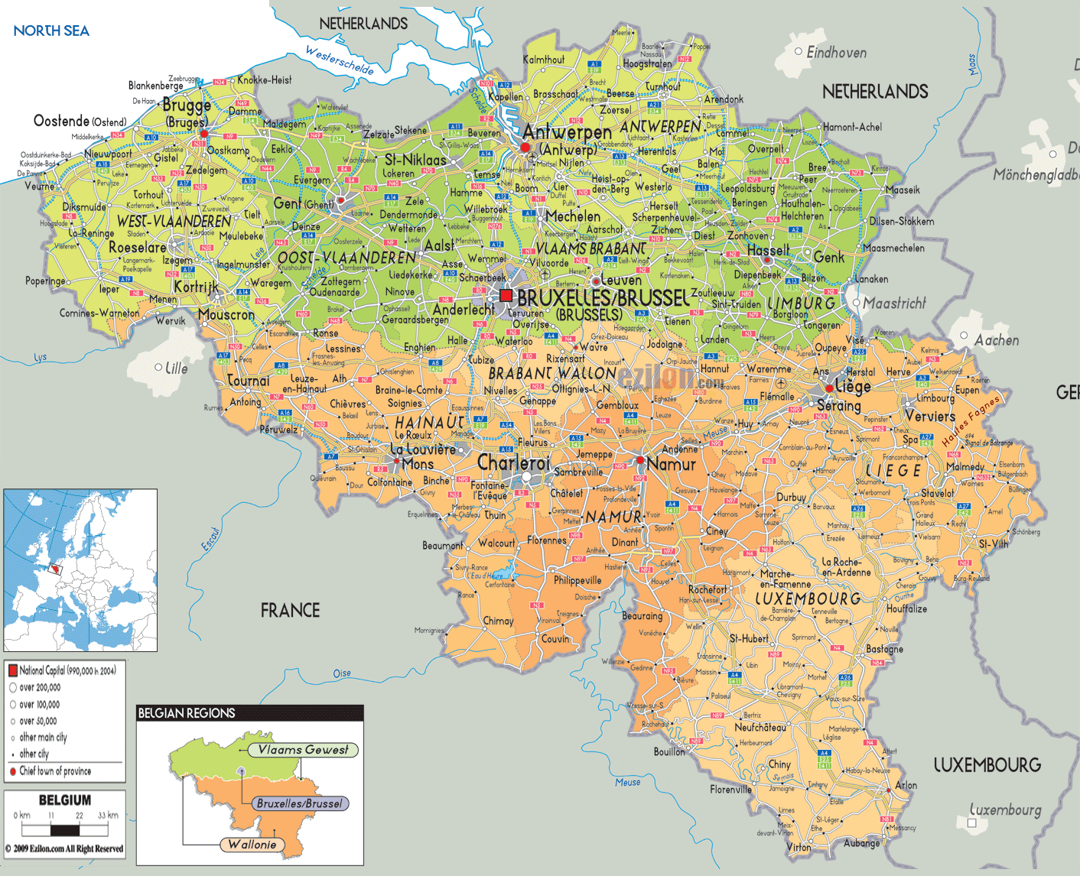

Slide 4

KEY POINTS TO SHARE WITH WHOLE GROUP
Regulation
Certification
Preparation to teach

Slide 5

Regulation
Finland
3 years
master
Lithuania
no less than master
< 10% PHD
Belgium
no regulation

Slide 6
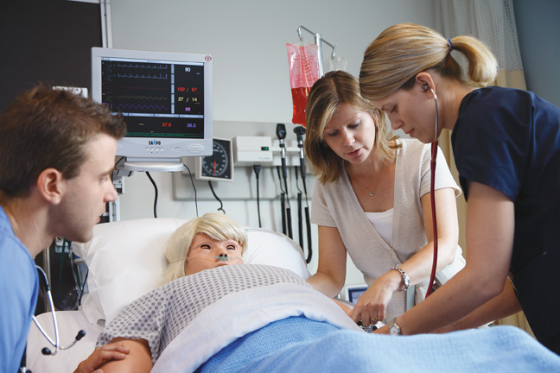
Certification
Finland
95% nurses
5% physicians or others
Lithuania
90% nurses
10% others
Belgium
90 to 95% nurses
5% others

Slide 7

Preparation to teach
Finland
pedagogical education is demanded, not obliged
no less than 3 years’ experience
Lithuania
no less than master in nursing sciences
no less than 3 years’ experience
no pedagogical education obliged
Belgium
no legal requirement
prefer: master
pedagogical education is demanded, not obliged

Slide 8

Specific programmes for nursing teachers?
Finland
60 ECTS for teaching = general programme on masters level
inside the master programme
Lithuania
nothing
Belgium
60 ECTS for teaching = general programme on masters level
also a teacher programme on bachelors level

Slide 9

Future? What do we wish?
Finland
50% in school + 50 % in clinical setting ( they don´t know enough anymore about the clinical setting)
masters degree = OK + also research
Lithuania
50% in school + 50 % in clinical setting
Belgium
minimum master degree
educational skills + also research

Slide 10
WORK GROUP 2

Slide 11

Strenghts
flexibility
holistic and pluralistic vision
people skills
stress-proof
analytic skills
master skills
education skills
working experience
enthusiasm
knowledge of learning proces (student-centered learning)
knowledge of curriculum
knowledge of the big picture (standards)
motivation for innovation
cultural competences
LLL & CPD

Slide 12
Weaknesses
lac of didactic education
lac of the overall vue (curriculum)
difficult to stay up to date with the nursing practice
ICT-skills
problems with workload due to enthusiasm (how to say ´no´)
balance between future nursing skills and nursing reality
problem to see the difference what the advantage is for 3,5 year study
frustration that students get a diploma but are not ready to work in some clinical areas
update of education skills
difficulty to evaluate when the student does not obtain the goals (´´almost but not´´)
coherent teacher methods to the learning outcomes
no European requirements for nursing educators

Slide 13
Opportunities
E.R.
National directive for example Finland
Impact on the future of nursing (Phd)
Impact on the working live (processes, quality of care)
International research projects
FINE-activities (recommendations for nurse educators)
Working together with the working field

Slide 14

Threats
Time-management / Lean-management
Nursing science is not very well known
Attractivity (salary, hard work, …) and image of the profession
Not enough clinical placements
Financial pressure (let pass the students, even if they haven´t obtained the learning outcomes!)

Slide 15
